Slide 1
Podcast Plus: A Redux-Inspired Podcast App with Dynamic Themes for Android
Team Members:
T. Rudhuvarman(4252A7528E4315993E8421CFF33B5A9C)
K. Harishkanna(58830B2F285B78CA2054D901DB616A3B)
S. Abishek(3A98F78F6C7E88093AA4134E025CB71C)
M.B. Pranav Nathan(4A8F00A7D05AEC2B837474063C587DB4)

Slide 2
Podcast Plus: A Redux-Inspired Podcast App with Dynamic Themes for Android
Project Description:
A project that demonstrates the use of Android Jetpack Compose to build a UI for a podcast player app.
The app allows users to choose , play and pause podcasts.

Slide 3
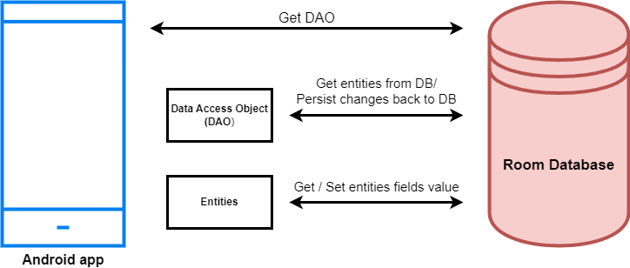
Architecture

Slide 4
Learning Outcomes :
By end of this project:
You’ll be able to work on Android studio and build an app.
You’ll be able to integrate the database accordingly.
Project Workflow:
Users register into the application.
After registration , user logins into the application.
User enters into the main page
The app allows users to choose , play and pause podcasts.

Slide 5
Note:
To complete the project you need to finish up the tasks listed below:
Tasks:
1.Required initial steps
2.Creating a new project.
3.Adding required dependencies.
4.Creating the database classes.
5.Building application UI and connecting to database.
6.Modifying AndroidManifest.xml
7.Running the application.

Slide 6
Required initial steps
This milestone explains about required initial steps.
https://developer.android.com/studio/install
Creating a new project.
Step 1 : Android studio > File > New > New Project > Empty Compose Activity
Step 2 : Click on Next button.

Slide 7
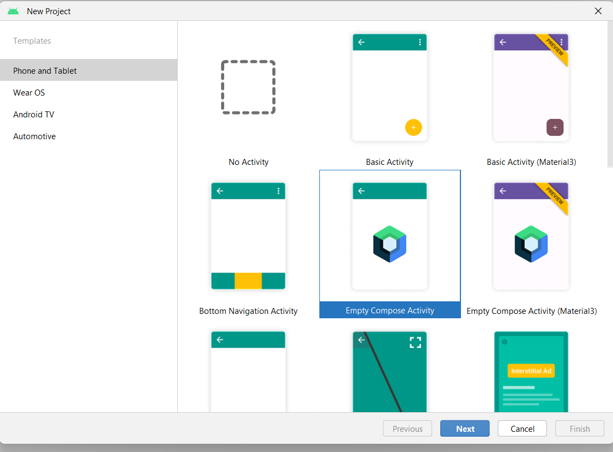
Step 3 : Give name to the new project.
Step 4 : Give the Minimum SDK value
Step 5 : Click Finish

Slide 8
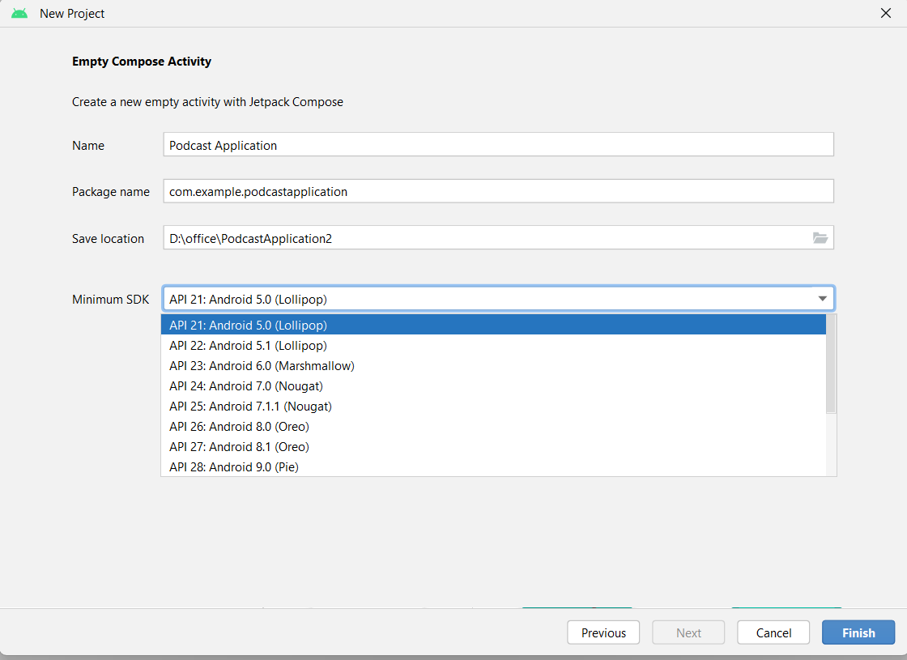

Slide 9
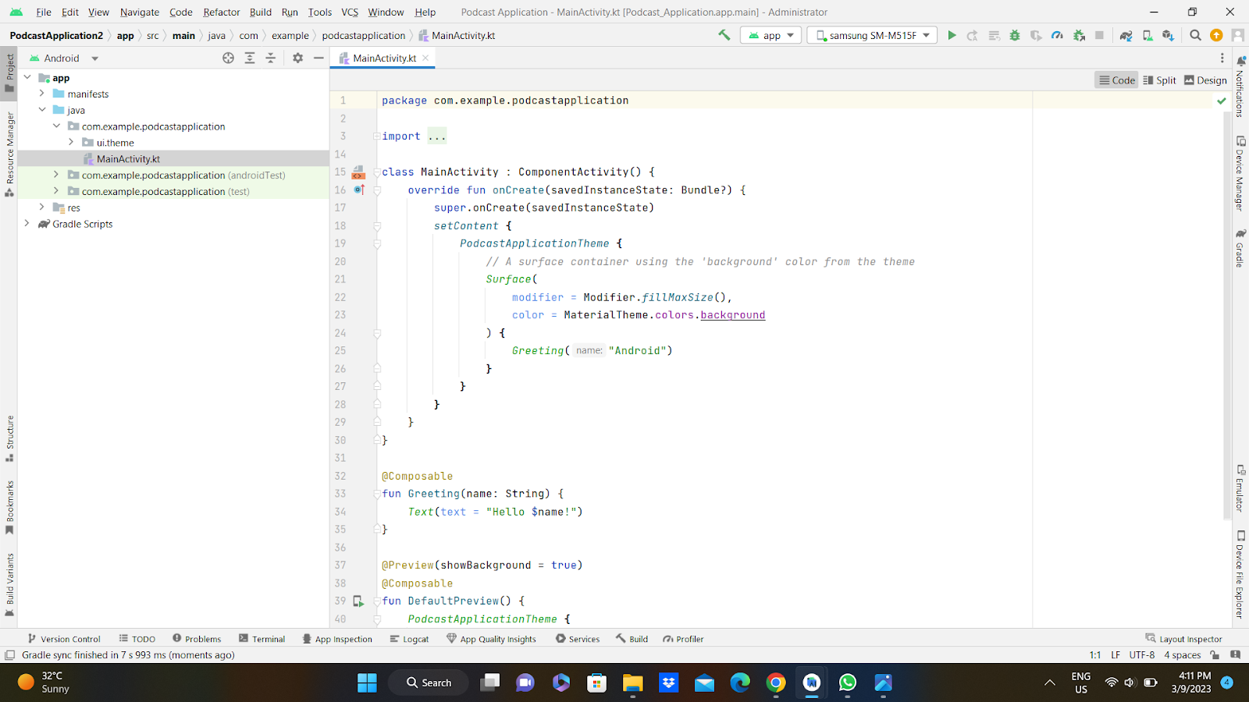
Main activity file

Slide 11
Adding required dependencies.
This milestone explains about adding required dependencies.
Creating the database classes
Creating the database classes
To learn more about Database follow this link:
https://gorillalogic.com/blog/android-room-tutorial-simplifying-how-you-work-with-app-data/

Slide 12
Too Much Talk—Let’s Look at an Example of Android Room
All the sample code is written using Kotlin (if you don’t know Kotlin or you want to learn more, I invite you to read my article about it).
The first thing we need to do is to update our gradle file. It should look like this:

Slide 13
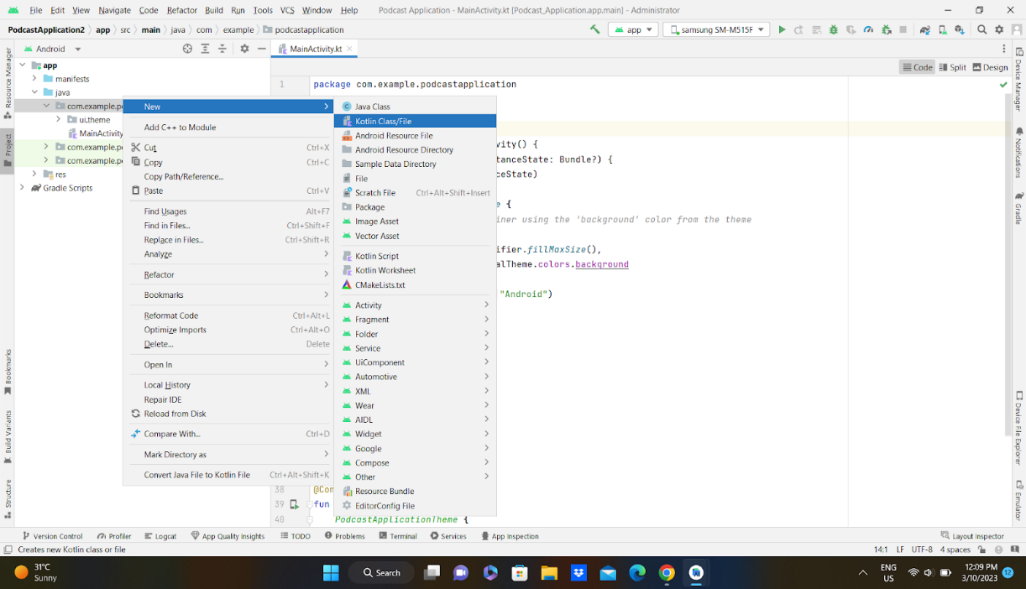
Create User data class
Create User data class

Slide 14
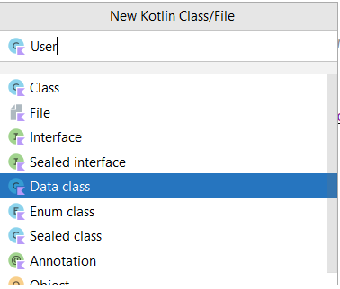
User class code:
https://github.com/smartinternz02/PodcastPlayer/blob/master/app/src/main/java/com/example/podcastplayer/User.kt

Slide 15
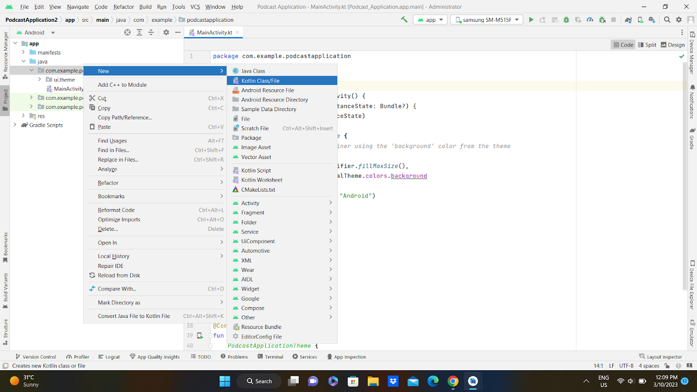
Create an UserDao interface
Create an UserDao interface

Slide 16
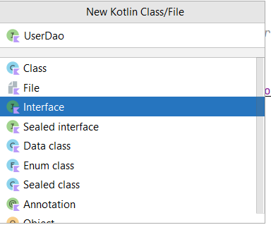
UserDao interface code:
https://github.com/smartinternz02/PodcastPlayer/blob/master/app/src/main/java/com/example/podcastplayer/UserDao.kt

Slide 17

Create an UserDatabase class
Create an UserDatabase class

Slide 18
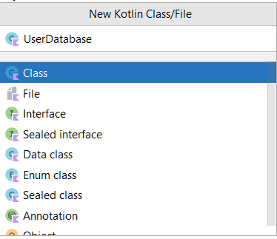
UserDatabase class code :
https://github.com/smartinternz02/PodcastPlayer/blob/master/app/src/main/java/com/example/podcastplayer/UserDatabase.kt

Slide 19
Building application UI and connecting to database
In this milestone, you will go through the Building Application UI and Connecting to database.
Creating LoginActivity.kt with database
Creating LoginActivity.kt with database

Slide 20
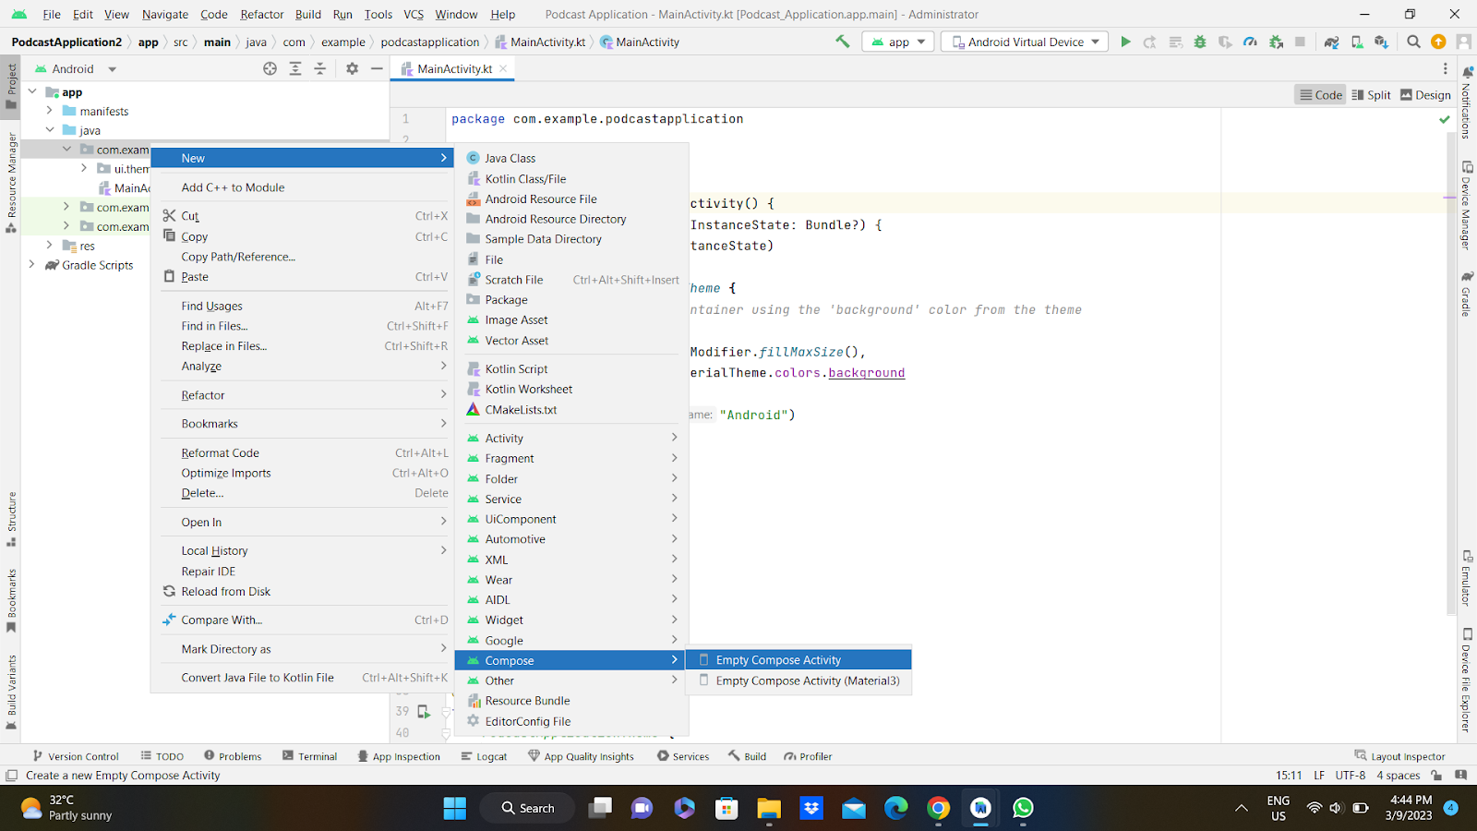

Slide 21
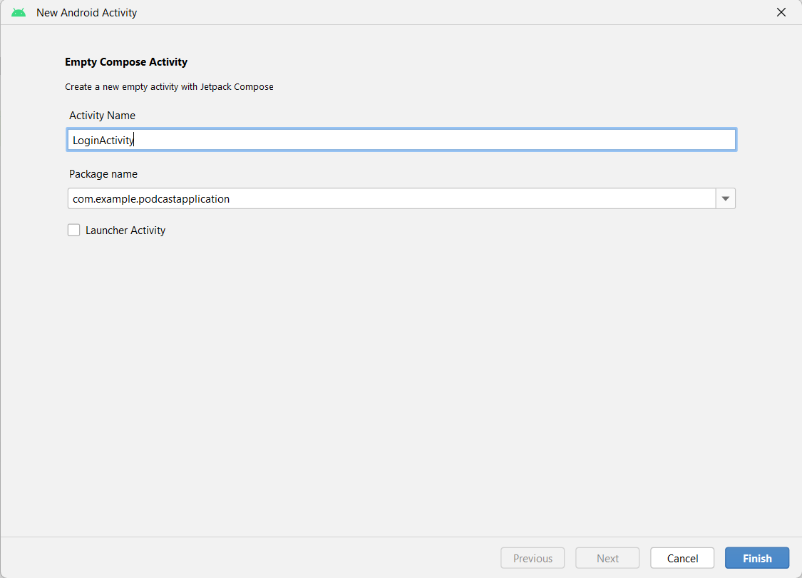
Database connection in LoginActivity.kt

Slide 22
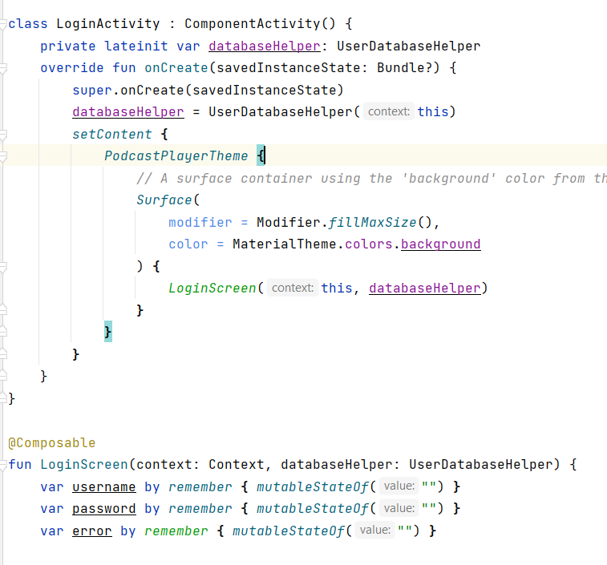

Slide 23
Complete code in below link
https://github.com/smartinternz02/PodcastPlayer/blob/master/app/src/main/java/com/example/podcastplayer/LoginActivity.kt
Database connection in RegistrationActivity.kt
Creating RegistrationActivity.kt with database

Slide 25
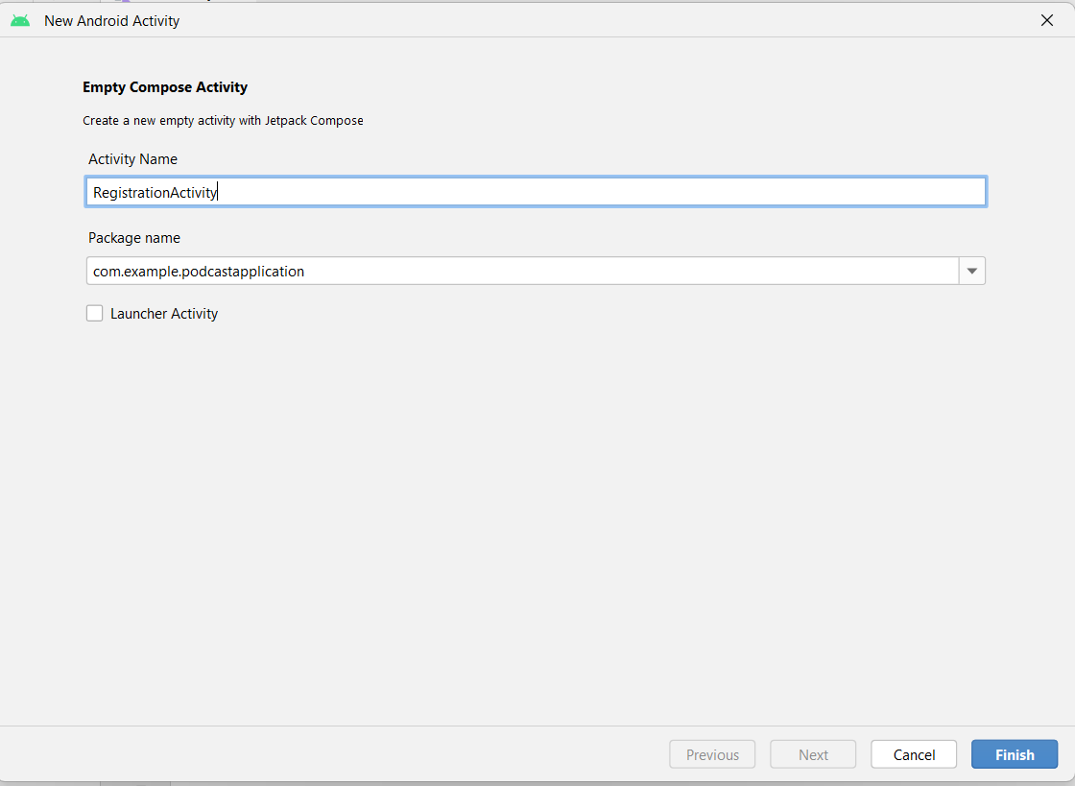
Database connection in RegistrationActivity.kt

Slide 26
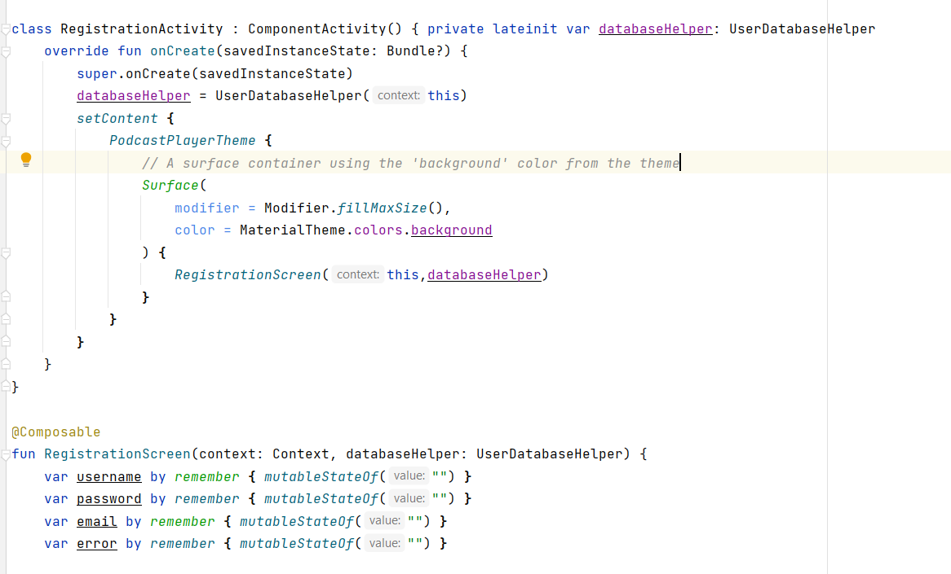
Complete code in below link:
https://github.com/smartinternz02/PodcastPlayer/blob/master/app/src/main/java/com/example/podcastplayer/RegistrationActivity.kt

Slide 27
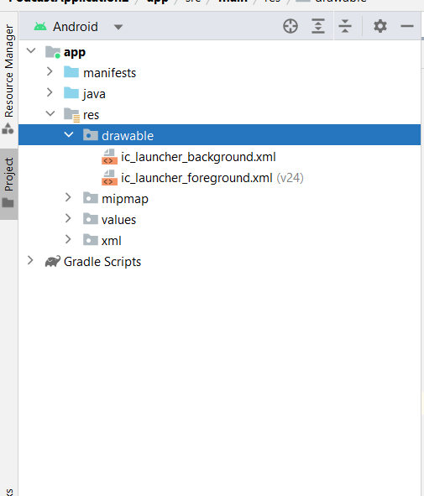
Creating MainActivity.kt file
In MainActivity.kt file the main application is developed
Before creating UI we need to add some images in drawables which are in res

Slide 28
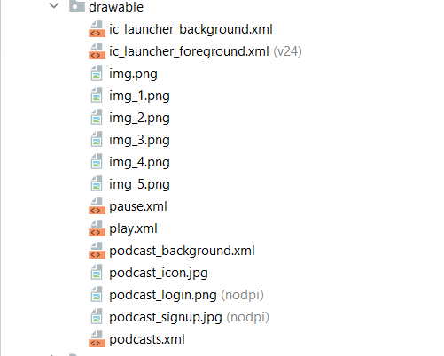
Download the required drawable from the code:
https://github.com/smartinternz02/PodcastPlayer/tree/master/app/src/main/res/drawable
Required drawables

Slide 29
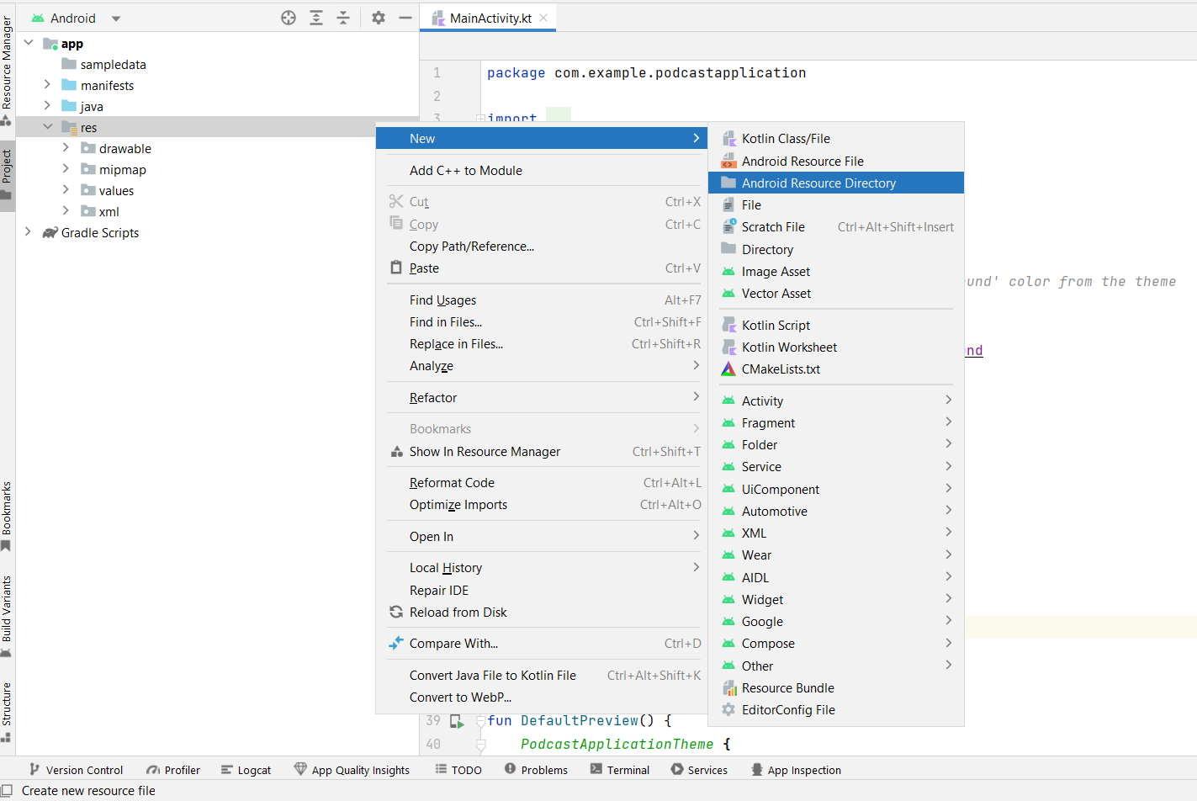
After adding drawables we need to add the required audio files

Slide 30
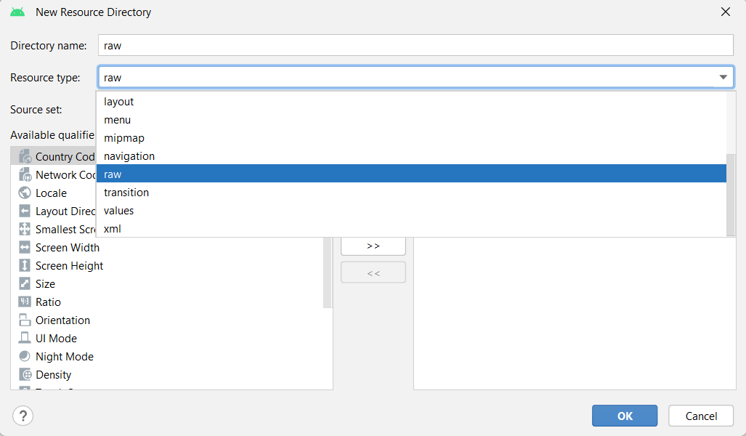
Next click OK

Slide 31
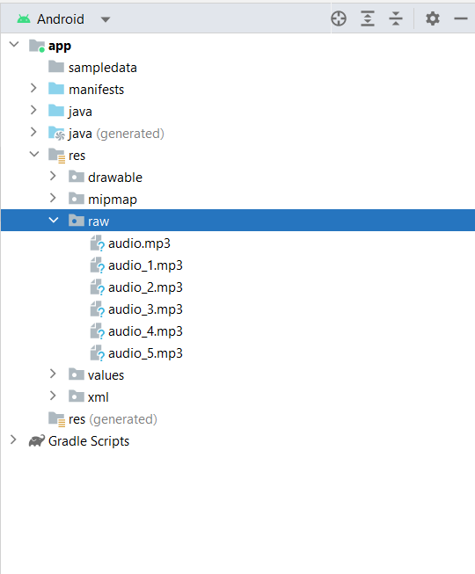
Add the downloaded audio into raw by copy and paste of the file

Slide 32
You can download the files from below link
https://github.com/smartinternz02/PodcastPlayer/tree/master/app/src/main/res/raw
After add all this we need to create the UI in MainActivity.kt file
MainActivity.kt file
Complete MainActivity.kt code:
https://github.com/smartinternz02/PodcastPlayer/blob/master/app/src/main/java/com/example/podcastplayer/MainActivity.kt

Slide 33
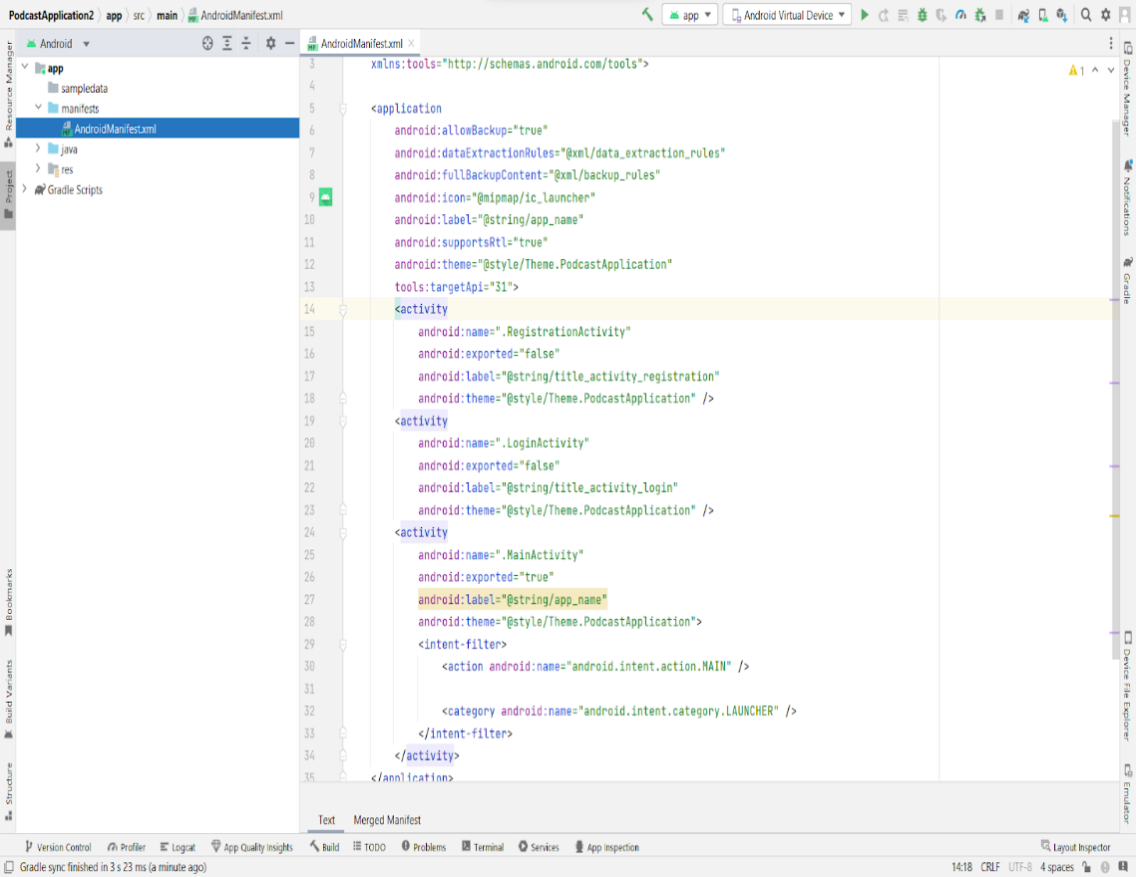
Modifying AndroidManifest.xml
Modifying AndroidManifest.xml

Slide 34
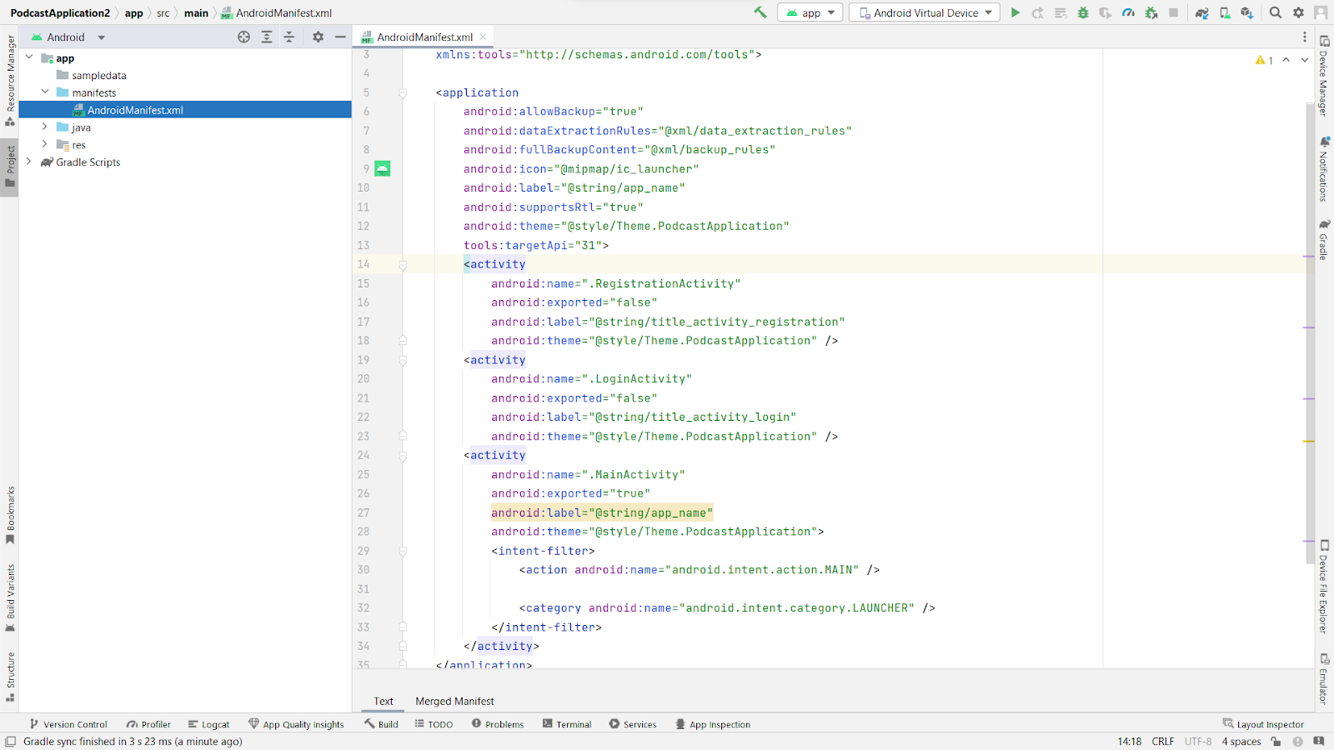
When we run the app we will get the MainActivity.kt file as our first screen , but we want LoginActivity.kt , So we need to change in AndroidManifest.xml.

Slide 35
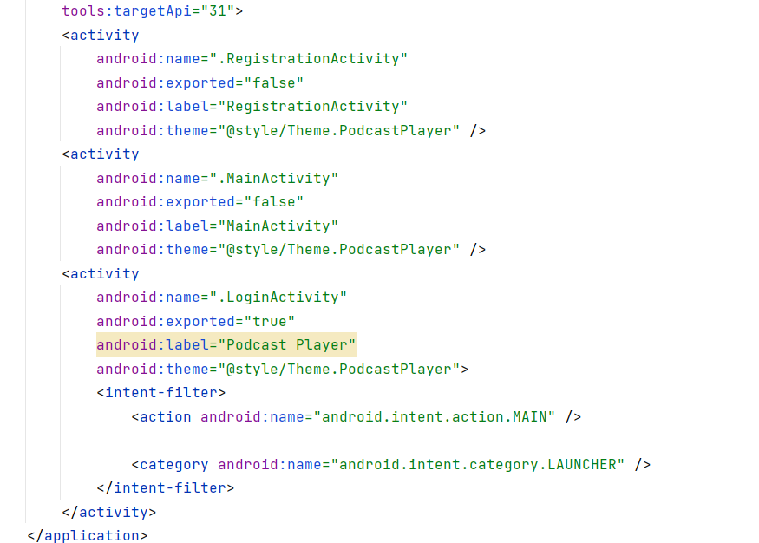
Changed AndroidManifest.xml.
Complete code is given below:
https://github.com/smartinternz02/PodcastPlayer/blob/master/app/src/main/AndroidManifest.xml

Slide 36
Running the application
This milestone, explains about how to run the application.
Run apps on a hardware device
Run apps on a hardware device
https://developer.android.com/studio/run/device

Slide 37
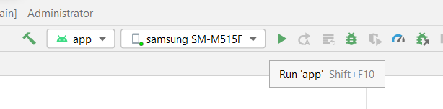
Run the application in Mobile
Run the application in Mobile

Slide 38
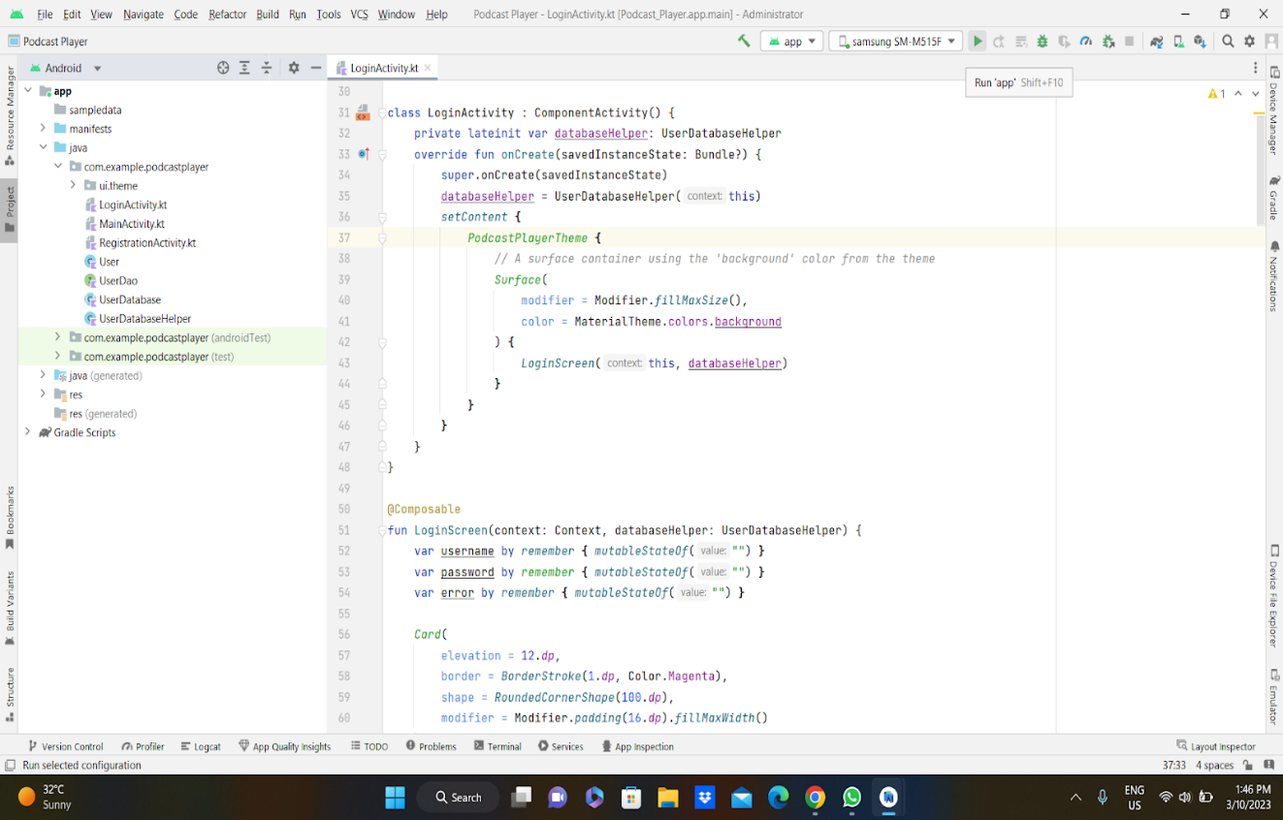
Complete Project Link: https://github.com/smartinternz02/PodcastPlayer

Slide 39
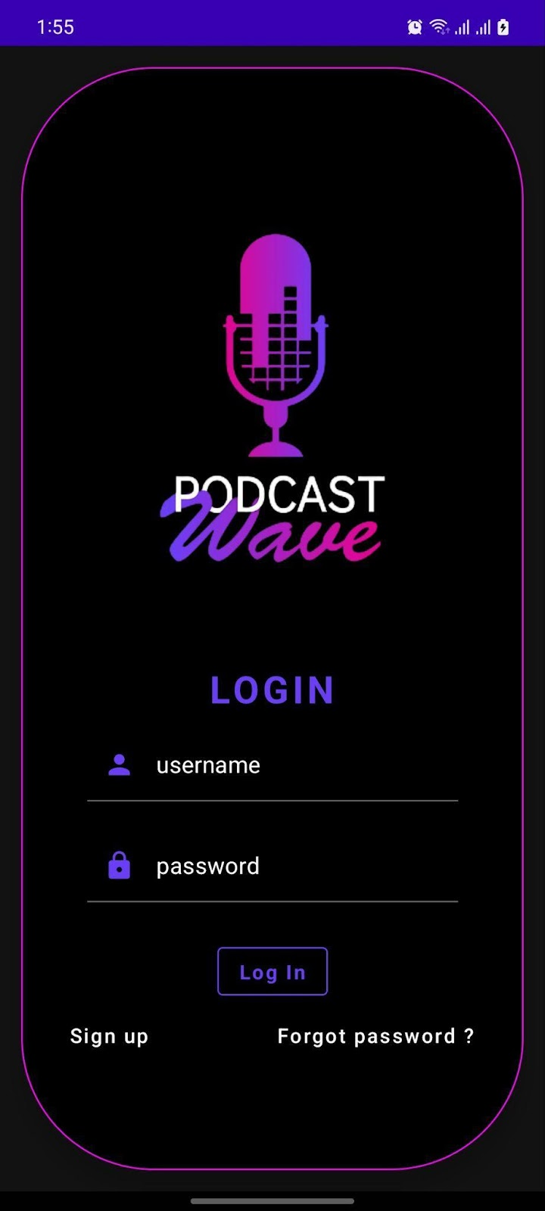
Final Output of the Application :
Login Page

Slide 40
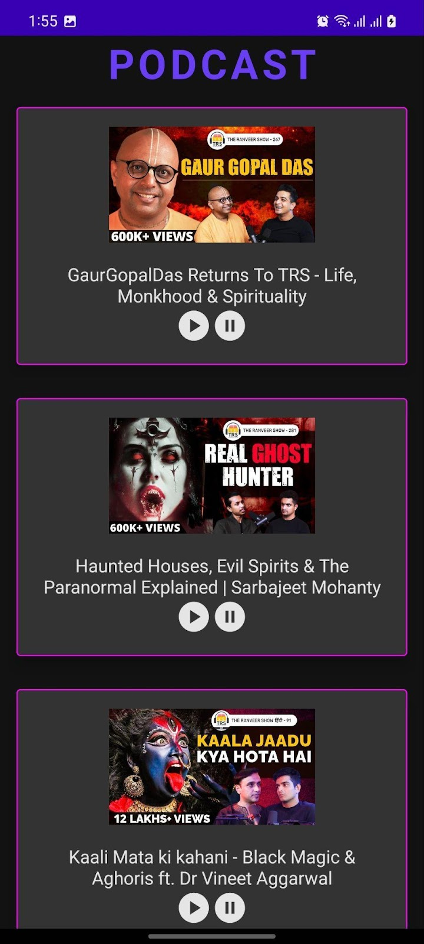
Main Podcast Page :

Slide 41


